Slide 1
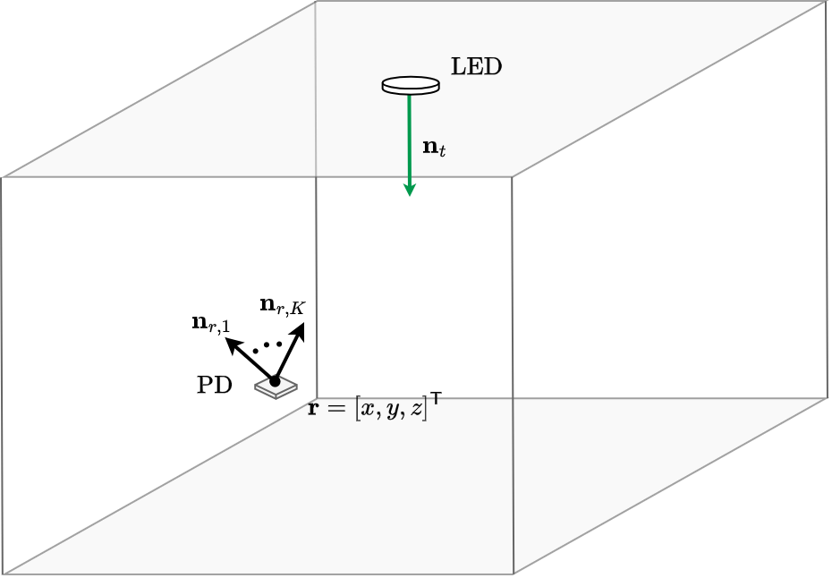
SETUP
Responsivity
Position of the LED
A (constant gain), m (order)

Slide 2
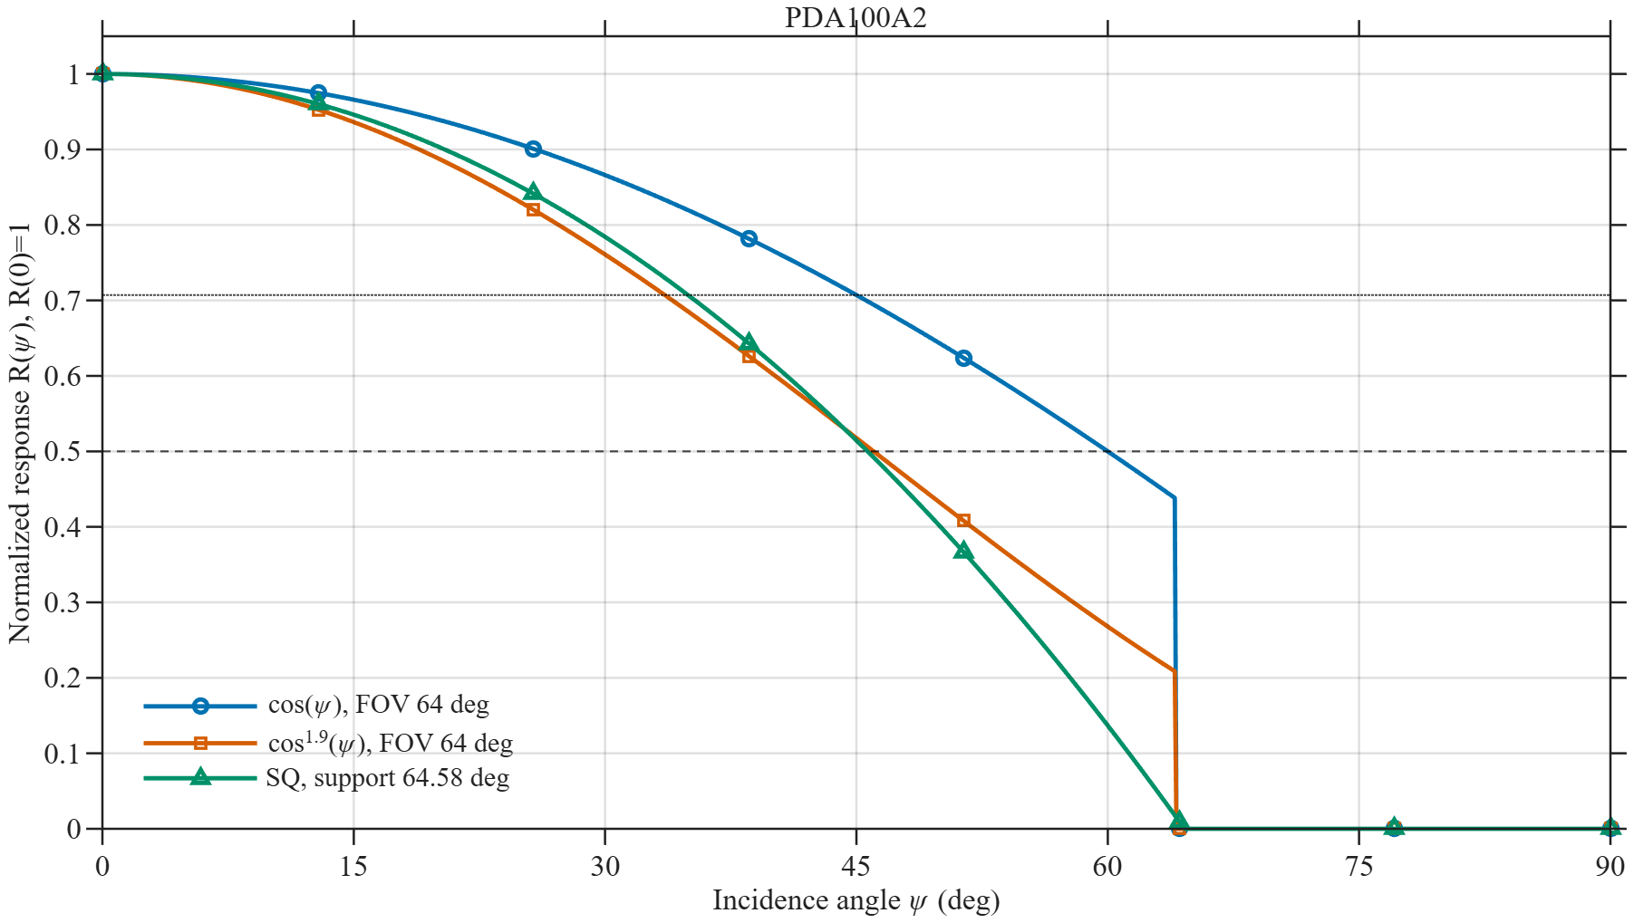
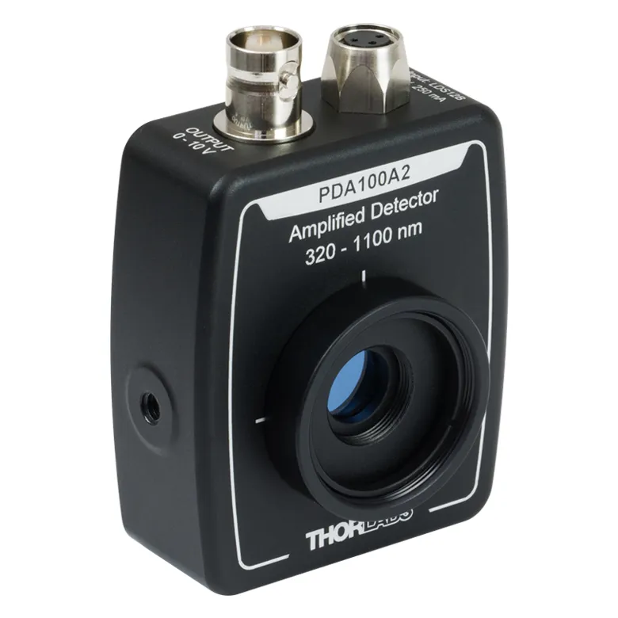




RESPONSIVITY
$$\cos{(ψ)}$$
Conventional but less accurate
Most accurate but less standard
$$1−Cψ^{2}$$
Generalizable and clean
$${\cos{(ψ)}}^{m_{R}}$$
$$FOV$$

Slide 3
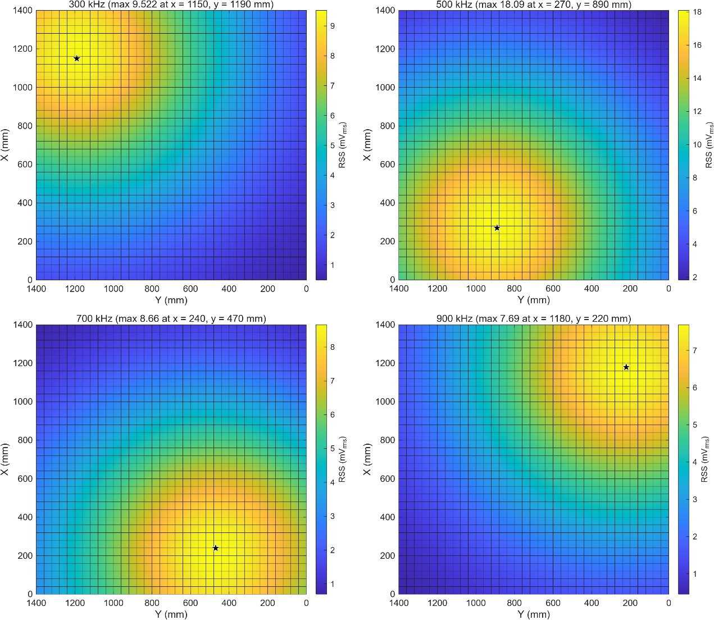
Database 1 (141x141 , 1cm)
Where are the sources, A, m?

Slide 4
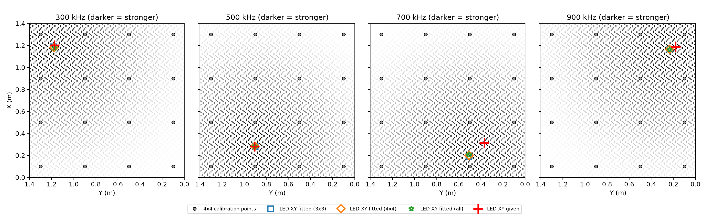

Slide 5
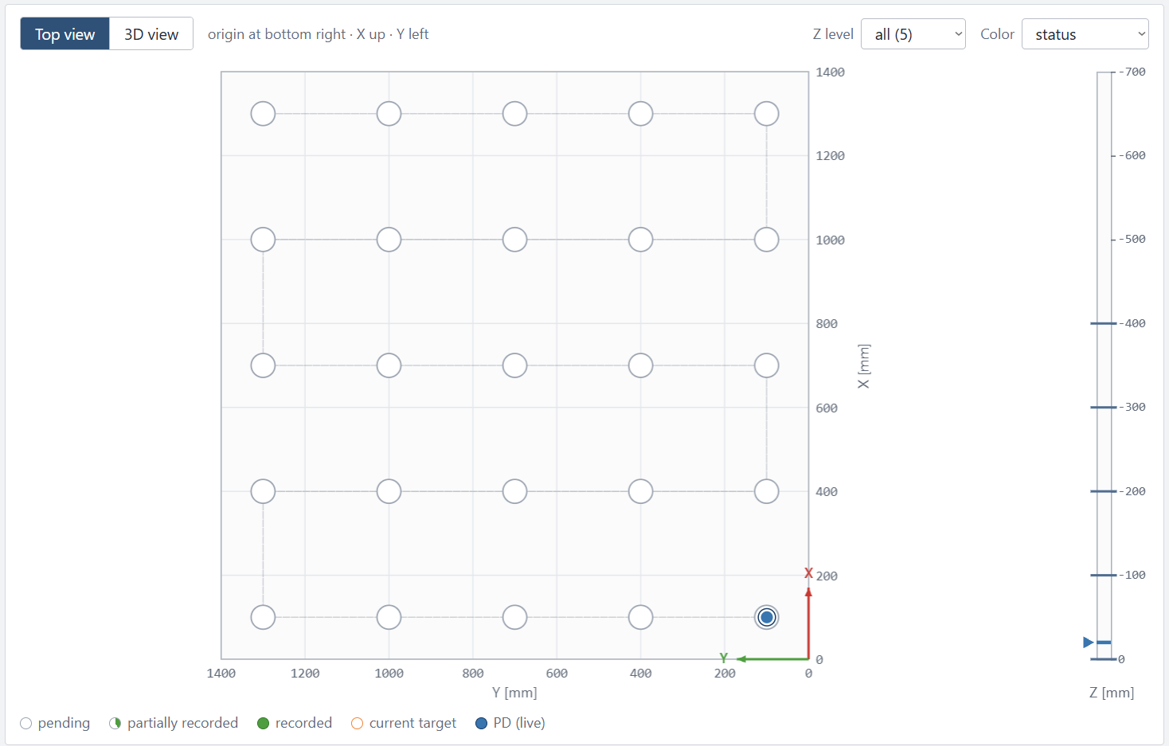
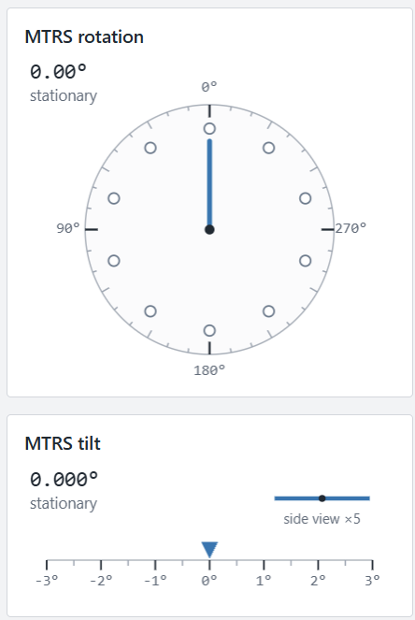
Database 2

Slide 6
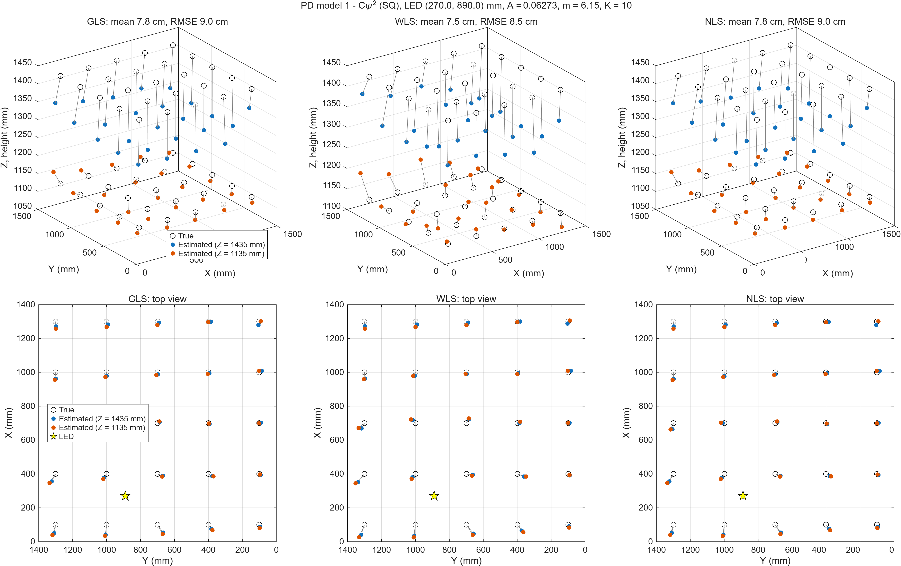

Slide 7
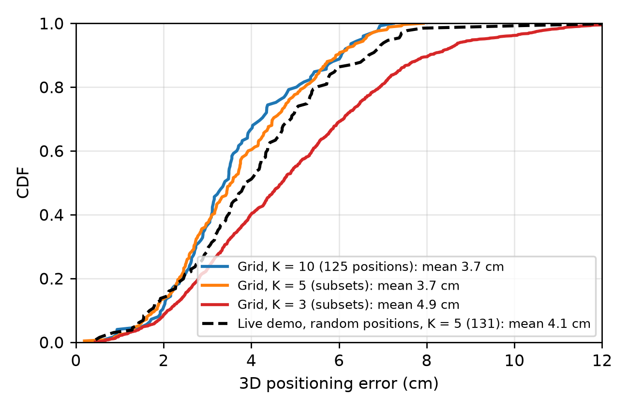

Slide 8
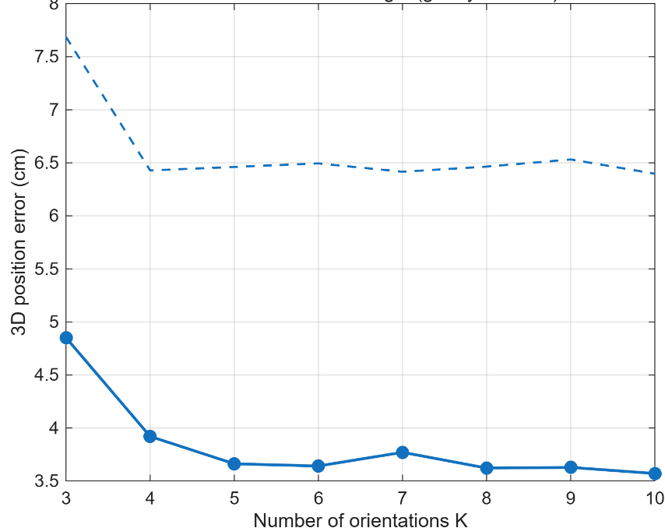
Number of orientation

Slide 9
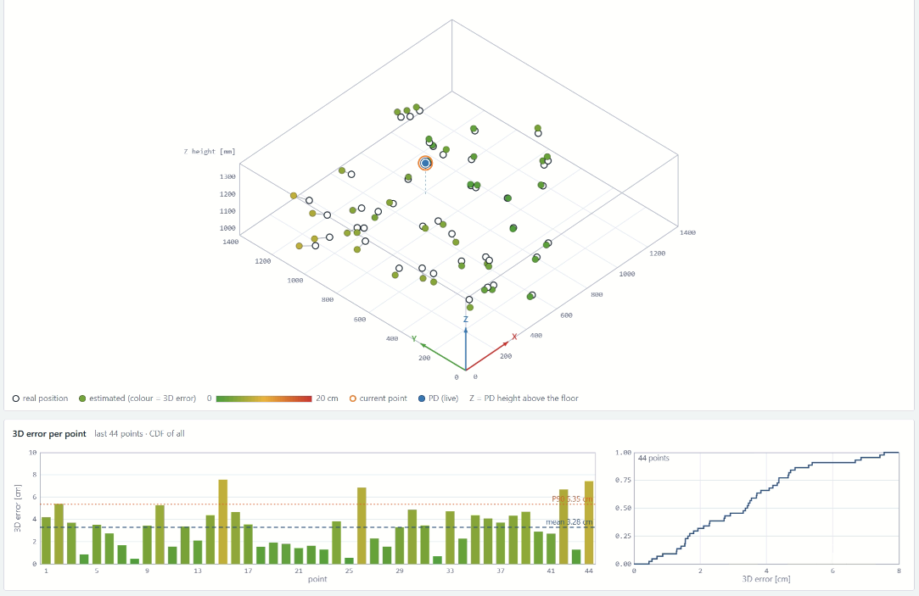
Database 3 : Test

Slide 10
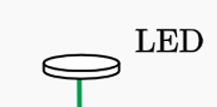
SETUP
Responsivity
Position of the LED
A (constant gain), m (order)

Slide 11
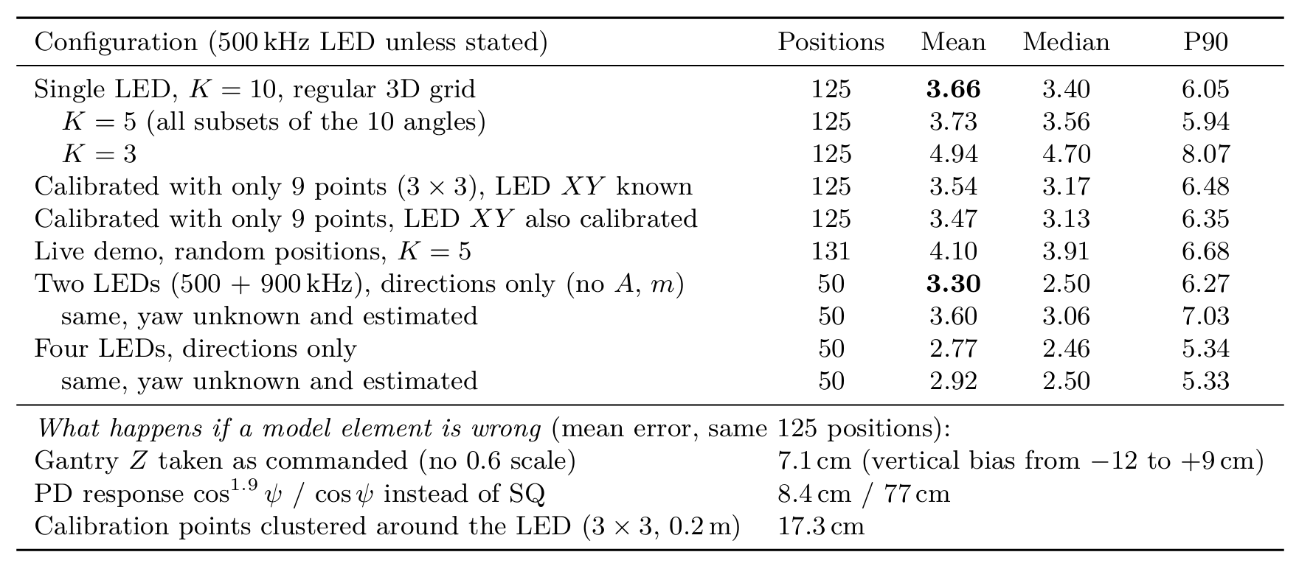

Slide 12
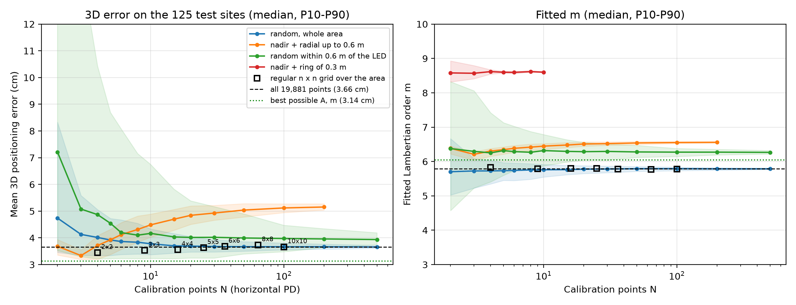

Slide 13
Github

Slide 14
